Slide 1
2017 JPL DATV Presentation
Pasadena, CA
Current Advances
in Digital-ATV
by
Ken Konechy W6HHC
W6HHC@ARRL.net
Robbie Robinson KB6CJZ
KB6CJZ@ARRL.net

Slide 2
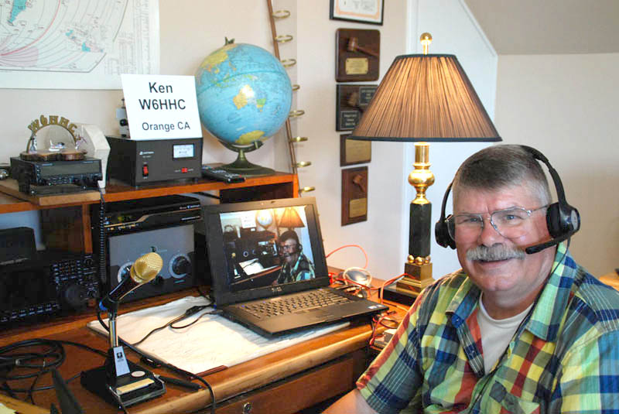
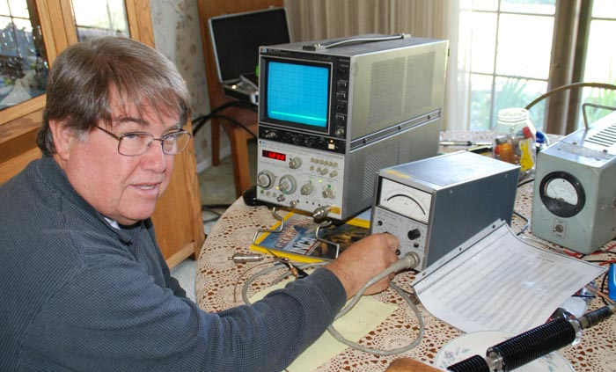
Digital-ATV
The Presentation Authors….
Ken W6HHC
Robbie KB6CJZ
2

Slide 3
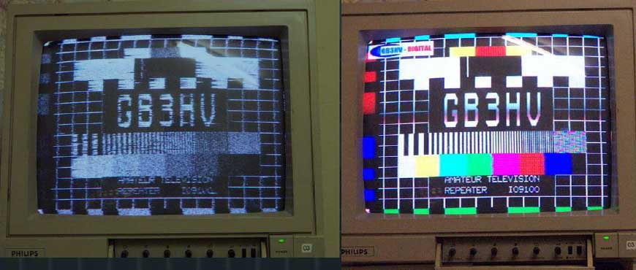
Digital-ATV
Digital-ATV technology allows Video Quality to exceed analog-ATV
Comparison of analog video and an DATV video using the same antennas with weak sigs
(courtesy of G8GTZ & GB3HV)
3

Slide 4
Digital-ATV
Status of Digital-ATV Today
DATV Video Quality can exceed analog ATV
Few hams transmit DATV in USA today
European DATV is very active and growing
Australia/New Zealand have lots of DATV activity
In 2017, there are finally 16 DATV-repeaters in USA
Digital-ATV transmitters had been expensive
US $900-and-up for MPEG/DVB-S Encoder/Transmitters
DATV Transmitter was cost barrier for most in USA
4

Slide 5
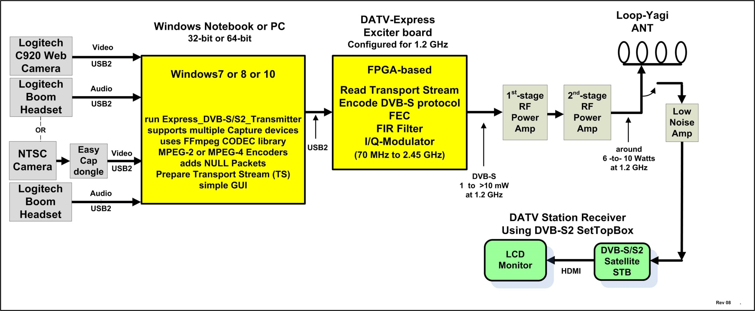
Digital-ATV
Block Diagram of DATV Station
Typical System Block Diagram for DVB-S DATV Station
5

Slide 6
Digital-ATV
Different Protocols used for DATV
DVB-S (satellite based)
DVB-S2 (satellite for HDTV)
DVB-T (terrestrial reception)
ATSC (commercial terrestrial reception in US)
ITU-T J.83B (US/Canada cable television)
6

Slide 7
Digital-ATV
DVB-S Protocol used for DATV
DVB-S is used for commercial satellite downlinks
DVB-S was designed for commercial SD-DTV
Protocol allows only QPSK Digital modulation
Protocol typically calls for MPEG-2 encoding
RF bandwidth is variable = 1.33 x Symbol-Rate
Hams have hacked RF bandwidth down to 0.5 MHz
very widely used by hams
7

Slide 8
Digital-ATV
DVB-S2 Protocol used for DATV
DVB-S2 used for commercial satellite downlinks
DVB-S2 was designed for commercial HD-DTV
Protocol allows following digital modulations:
QPSK (2-bits/symbol)
8PSK (3-bits/symbol)
16APSK (4-bits/symbol)
32APSK (5-bits/symbol)
Protocol typically calls for MPEG-4 encoding
RF bandwidth is variable = 1.2 x Symbol-Rate
There are licensing issues for ham radio usage
8

Slide 9
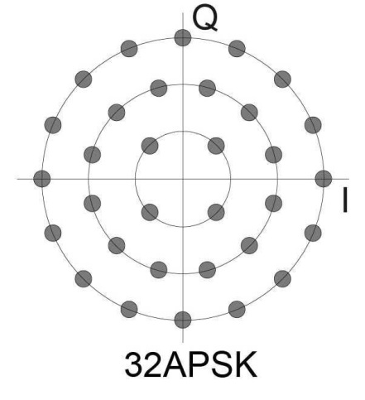
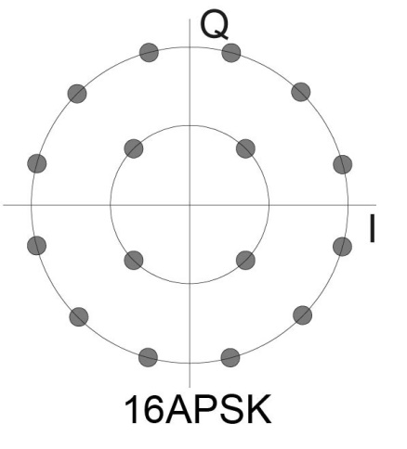
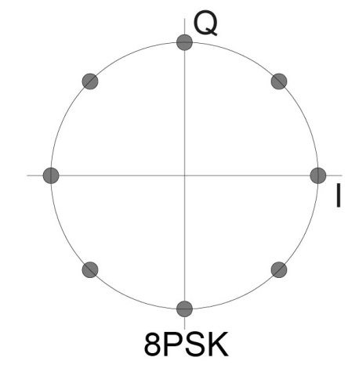
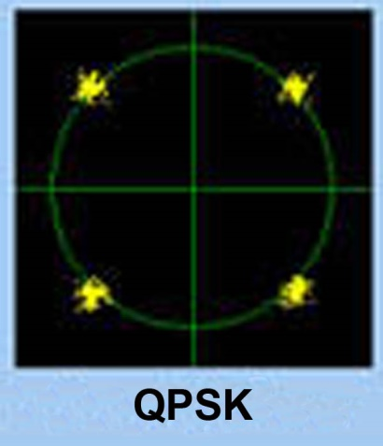
Digital-ATV
DVB-S2 Protocol – modulation technologies
9

Slide 10
Digital-ATV
DVB-T Protocol used for DATV
DVB-T was designed for commercial SD-DTV
COFDM protocol allows these digital modulations:
QPSK (2-bits/symbol)
QAM-16 (4-bits/symbol)
QAM-64 (6-bits/symbol)
RF bandwidth can be 1, 2, 3, 4, 6, 7, or 8 MHz
increasing usage by hams (repeater downlink)
Used by Amateur Television Network in LA mountains
10

Slide 11
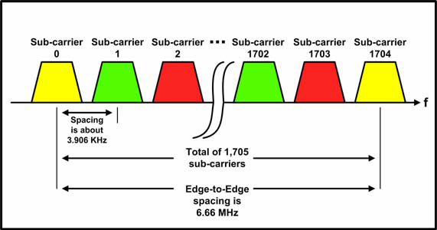
Digital-ATV
DVB-T Protocol used for DATV
COFDM technology allows 1705 sub-carriers (or more)
11

Slide 12
Digital-ATV
ATSC Protocol used for DATV
ATSC is used for US commercial TV reception
ATSC was designed for commercial HD-DTV
Protocol allows only one digital modulation:
8-VSB (3-bits/symbol)
Protocol typically calls for MPEG-2 video encoding and Dolby (AC3) sound encoding
RF bandwidth fixed at 8 MHz
Dolby licensing issues for ham radio usage
no current active ham experiments
12

Slide 13
Digital-ATV
RF Exciters for ham DATV
SR-Systems – MiniMod exciter + MPEG-2 encoder
DVB-S , DVB-T – about $875 as received in USA
DVB-S2 and ATSC – costs additional…also H.264 encoder was $900 additional
DATV-Express – exciter board + PC
DVB-S – $300 + shipping
DVB-S2 - $300 + shipping
DVB-T – (experimental 2 MHz bandwidth) $300 + shipping
Portsdown Project – exciter board + RPi-3
DVB-S – modulator blank PCB & blank filter PCB US$21 + parts + soldering + ship
DVB-S – can use DATV-Express as modulator board $300 + shipping
13

Slide 14
Digital-ATV
RF Exciters for ham DATV – cont’d
HiDes – exciter with MPEG-2 encoder + PC
DVB-T – model UT100B Tx/Rx about $250 + shipping on e-bay
DVB-T – model HV200E standalone (with MPEG-2 and H.264) $658 on e-bay
BATC – DTX1 exciter with MPEG-2 encoder
DVB-S – “standalone” model DTX1 about US$590 + shipping(?) on BATC shop
14

Slide 15
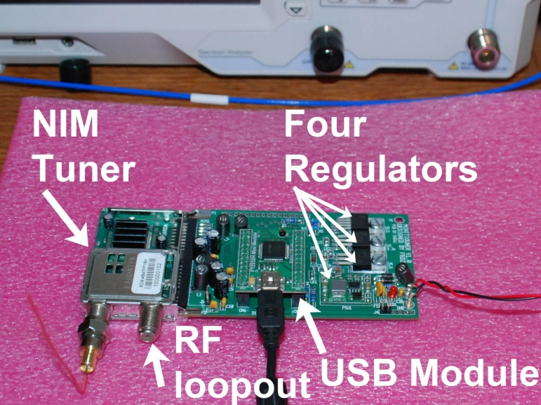
Digital-ATV
DATV Receivers – Ham-designed DVB-S/DVB-S2 Receiver and DATV Analyzer
MiniTiouner Low Symbol Rate designed by Jean Pierre Courjaud F6DZP
Allows Reduced-Bandwidth DATV (RB-DATV) for small BW & more signal robustness with reasonable reduction in Frame-Rate
S/N (C/N) improves 3 dB every time receiver RF bandwidth is cut in half
15

Slide 16
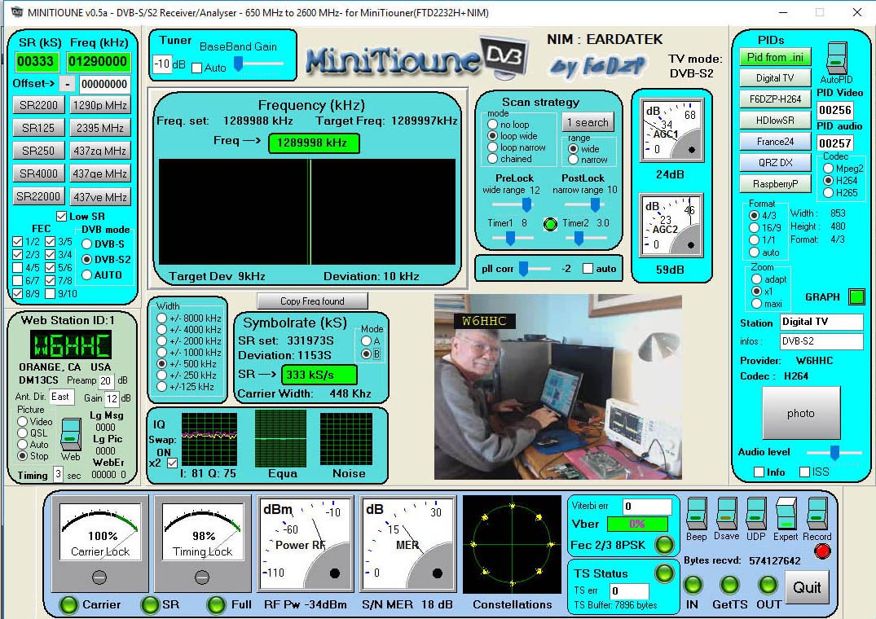
Digital-ATV
DATV Receivers – Ham-designed DVB-S/DVB-S2 Receiver and DATV Analyzer
MiniTiouner can not only full-screen-display the received DATV video, but is a powerful analyzer of DVB-S and DVB-S2 signals in the “Expert Mode”.
16

Slide 17
Digital-ATV
DATV Receivers - Low Symbol Rates were a blocker
MiniTiouner Low Symbol Rate testing by Jean Pierre Courjaud F6DZP
Commercial Receivers could not receive SR less than about 1500 KS/sec
S/N (C/N) improves 3 dB every time receiver RF bandwidth is cut in half
17

Slide 18
Digital-ATV
Goals of the DATV-Express Project
Significantly reduce price of Digital-ATV transmitters
Provide Plug-and-Play hardware board to minimize home construction.
Provide open platform for future DATV development
Help educate community about new technologies
Get more DATV stations on-air
Encourage wider audience to get ham licensed
Byproduct can be Software Defined Transmitter from 70 – 2450 MHz ham bands with a B/W of up to 10 MHz
18

Slide 19
Digital-ATV
The DATV-Express Project Team
Charles Brain - G4GUO Ferring, England
Ken Konechy - W6HHC Orange, CA, USA
Art Towslee - WA8RMC Columbus, OH, USA
Tom Gould - WB6P Portland, OR, USA
19

Slide 20
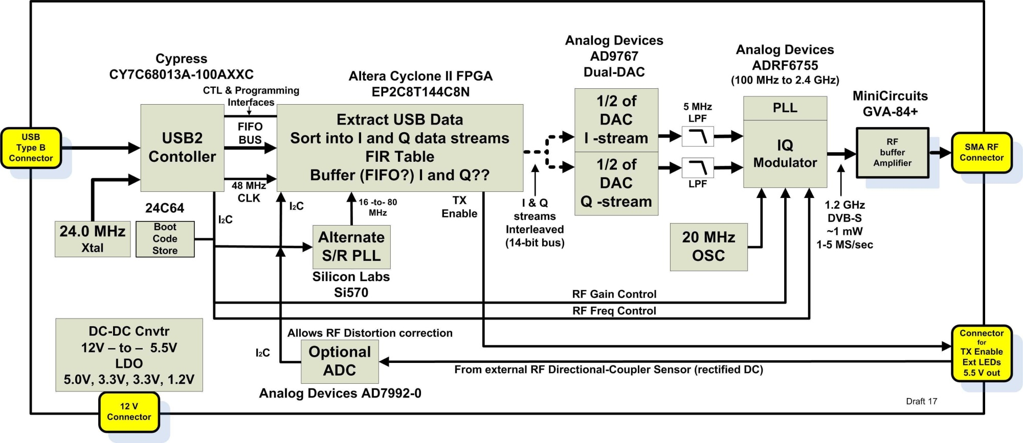
DATV-Express
DATV-Express board internal block diagram
Block Diagram for DATV-Express Hardware Board
20

Slide 21
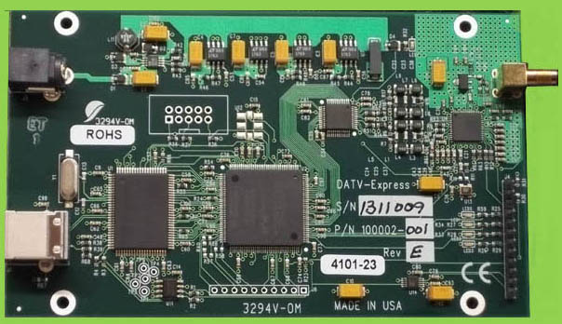
DATV-Express
DATV-Express hardware board
21

Slide 22
DATV-Express
DATV-Express System Specs
DVB-S protocol is tested and released
All IQ modulations fully tested
Frequency Range:
70–2450 MHz (Modulator chip specification)
Symbol-Rate:
Adjustable: 125 Ksymb/sec to 5 MSymb/second
Forward Error Correction is selectable
RF output ~ 1-20 mW buffered (SMA connector)
USB Webcam or Video Capture card for NTSC/PAL
PC Operating System – first Ubuntu-32/64-bit
Then was quadcore-ARM w/ Libuntu,
Then was Windows10 -32/64-bit
22

Slide 23
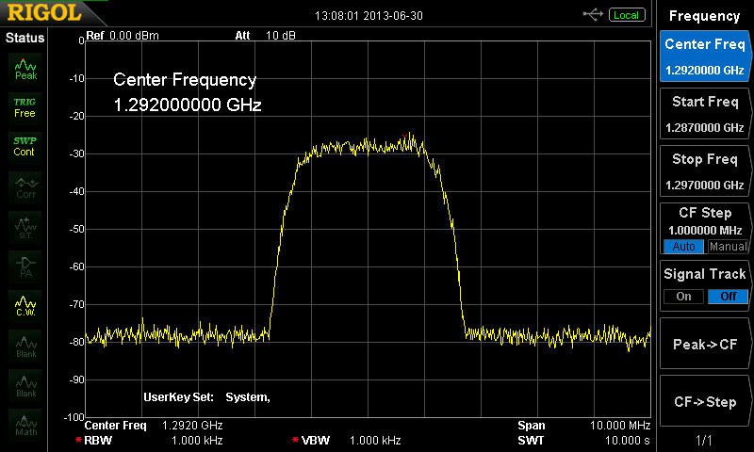
DATV-Express
Clean DVB-S 1.2 GHz spectrum
Barefoot board RF output – has 47 configurable levels of RF output
23

Slide 24
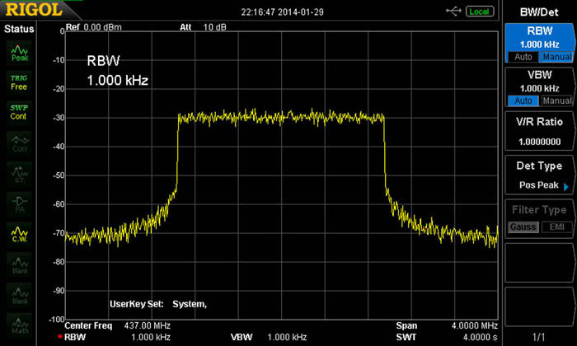
DATV-Express
DATV-Express capable of other DATV protocols used by hams
Testing DVB-T (2K mode) protocol at 2 MHz bandwidth on 437 MHz (using 4096-point iFFT math - with NO alias spurs)
24
Notes:
24

Slide 25
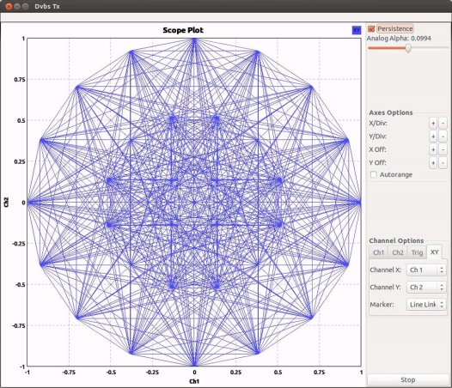
DATV-Express
GNU Radio with DATV-Express
Alex OZ9AEC has developed gnuradio “sink” module for DATV-Express – (see Github URL at end)
Ron W6RZ has adapted gnuradio to run DVB-S2 32APSK
W6RZ uses DATV-Express DVB-S2 code and tested with BladeRF & Novra S300V DVB-S2 STB at up to 10 MSym/s.
25

Slide 26
DATV-Express
Raspberry PI
Raspberry PI 3 has quad-core-ARM at 700 MHz
Raspberry PI 3 typically uses Raspbian Jesse Lite OS
Originally designed for education market
Raspberry-Pi-3 is used by Portsdown Project in Europe
Portsdown Project can use either Portsdown modulator brd
or the DATV-Express board as modulator
26

Slide 27
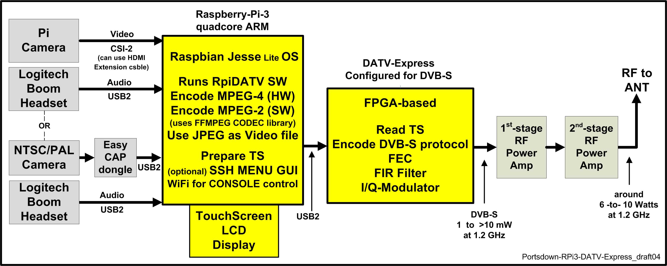
DATV-Express
Raspberry PI – DVB-S Portsdown Project
Portsdown Project using RPi-3 / RpiDATV SW / DATV-Express modulator
27

Slide 28
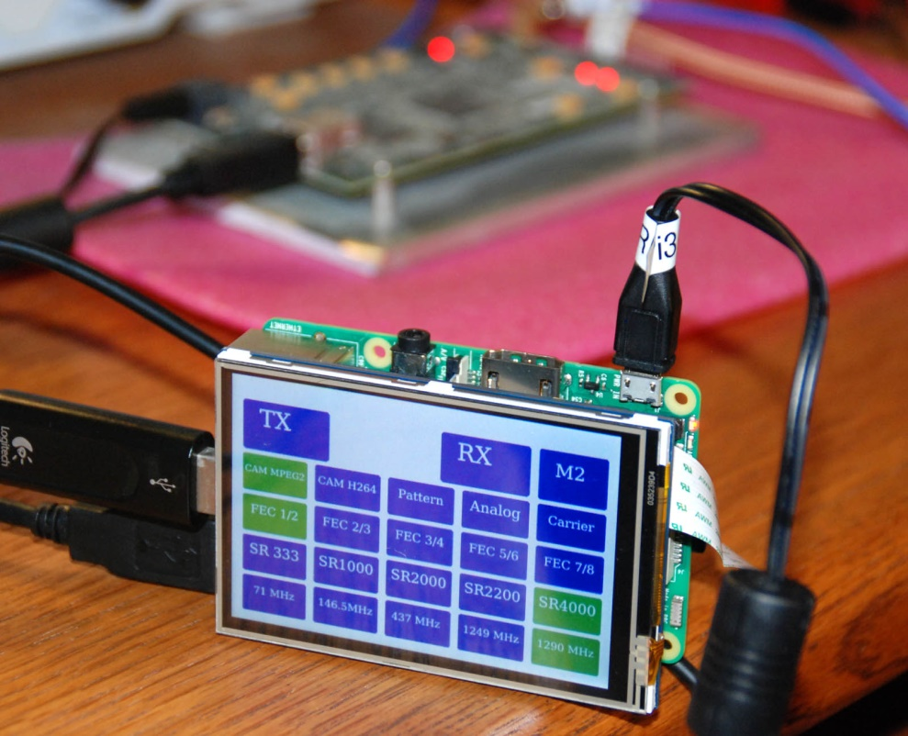
DATV-Express
Raspberry PI – DVB-S Portsdown Project
Portsdown Project using RPi-3 / RpiDATV SW / DATV-Express modulator
28

Slide 29
DATV-Express
Conclusion and Plans
DATV-Express Ubuntu 32/64-bit Code for PC is finished
DATV-Express Windows10 Code for PC is finished
Always looking for volunteers to help with software
Focus now is now porting to LimeSDR hardware board
(bigger FPGA & hardware for both Transmitting and Receiving)
Source files are available
(Software, FPGA coding, gerbers, etc.)
Beginnings of source code repository at https://github.com/G4GUO/datvexpress_gui.git

Slide 30
Digital-ATV
British ATV Club - Digital Forum
www.BATC.org.UK/forum/
CQ-DATV online (free monthly) e-magazine (ePub and PDF format)
www.CQ-DATV.mobi
OCARC library of newsletter DATV articles
www.W6ZE.org/DATV/
TAPR Digital Communications Conference proceedings (free downloads)
www.TAPR.org/pub_dcc.html
Yahoo Group for Digital ATV
http://groups.yahoo.com/group/DigitalATV/
DATV-Express project website
www.DATV-Express.com
HiDes (Taiwan) DVB-T D-ATV (Boards – and standalone)
www.HiDes.com.tw/product_cg74469_eng.html
Portsdown Project for DATV (RPi3-based BATC project for DVB-S)
http://batc.org.uk/forum/viewforum.php?f=103
SR-Systems (Germany) D-ATV components(Boards)
www.SR-systems.de and www.D-ATV.org

